Slide 1

DevOps case study Marcus Kielman

Slide 2

introduction
Design Phase
Setup Phase
Demonstration
Challenges/Improvisations

Slide 3
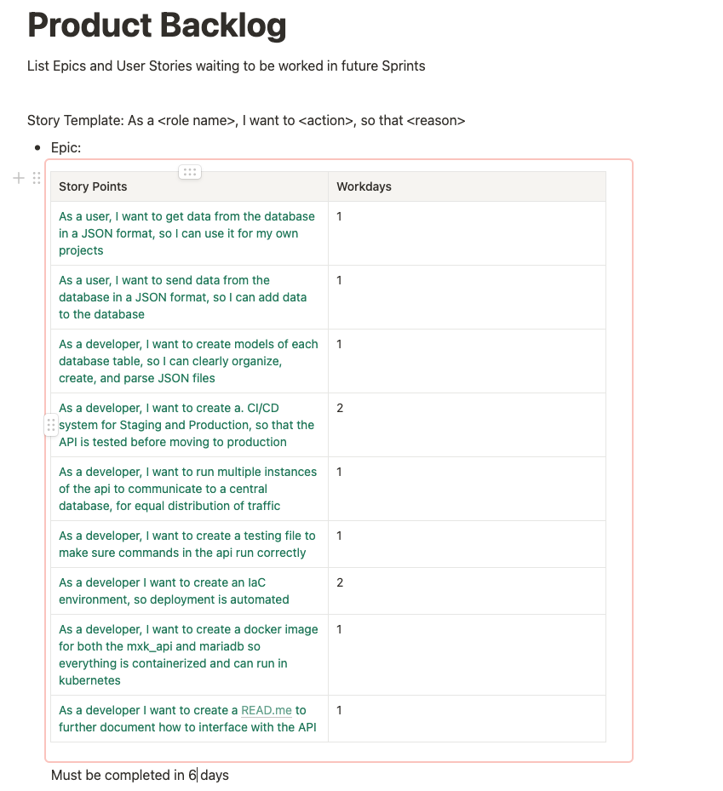
Design phase

Slide 4
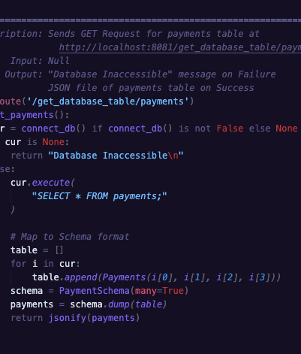
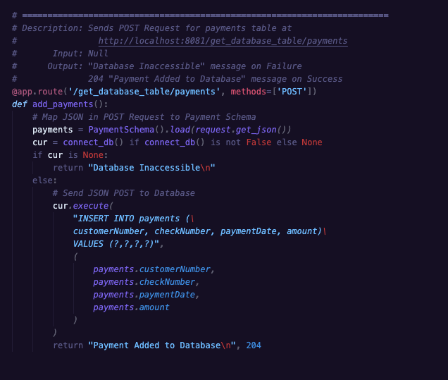
API design
API is a Flask app container that connects to a MariaDB database container
Allows execution of SQL inquiries through HTTP routes
List of HTTP routes
/ ---- Main API Page
/get_database_table ---- Database Tables
/get_database_table/payments ---- Payments Table
/get_database_table/customers ---- Customers Table
/get_database_table/offices ---- Offices Table

Slide 5
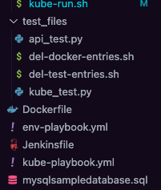
ci/cd & iac pipeline
Rolling Deployment
Simpler and more flexible
Goal: Seamless and expedient deployment that can be improved
Two types of IaC in pipeline
Testing Environment Installation:
env-playbook.yml
Kubernetes Deployment:
kube-playbook.yml

Slide 6
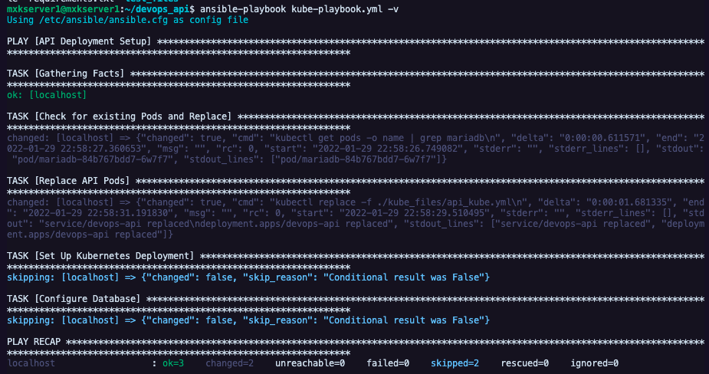
Setup phase

Slide 7
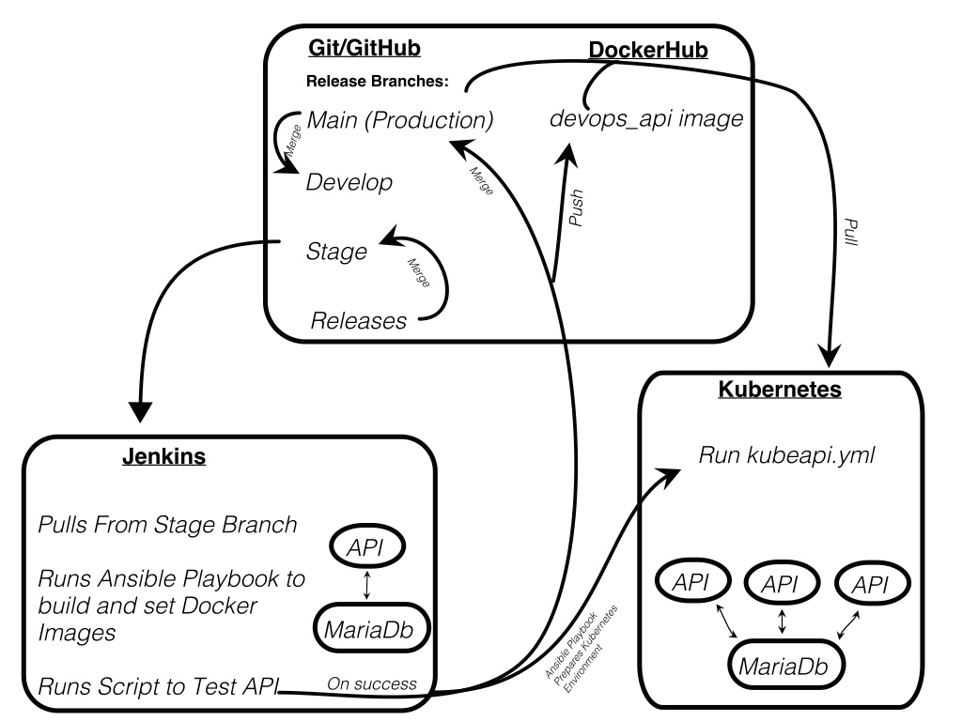
List of resources
Python 3.9 (Flask, marshmallow, mariadb, requests, flake8, pipenv)
Docker
Git/GitHub
Main
Develop
Stage
Feature Branches
Jenkins
Kubernetes
Notion

Slide 8
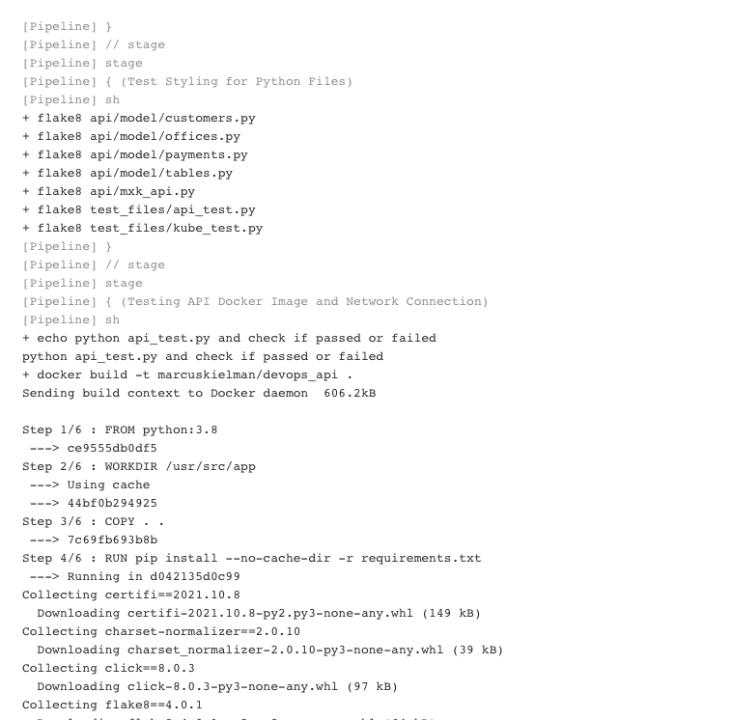
Steps for development
pipenv shell && pip install –r requirements.txt
Can also use pipenv to build docker images
Make changes and test locally
Push to feature repository, merge with Stage, and push Stage

Slide 9
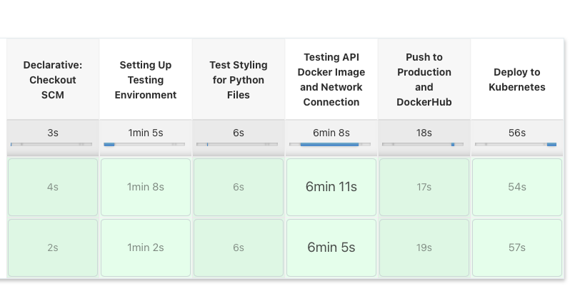
Steps for ci/cd deployment
Changes in main repository trigger a build in Jenkins and pulls from main branch
Jenkins runs env-playbook.yml
Build and run marcuskielman/devops_api image
Run marcuskielman/mariadb and add persistence
Run api_test.py and curl tests
Trigger Ansible to run kube-playbook.yml

Slide 10
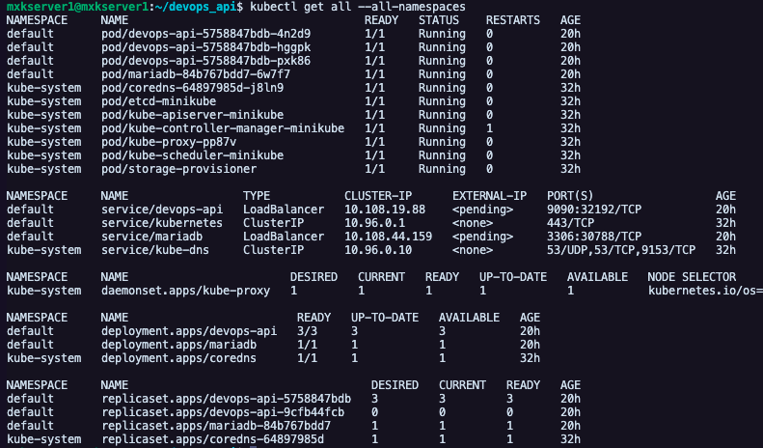
Steps for ci/cd deployment Cont.
Deployment pulls images to run deployment
Three or more api’s communicate with one database
Two types of deployment:
1. Initial deployment
(api_maria_kube.yml)
2. Update deployment
(api_kube.yml)

Slide 11
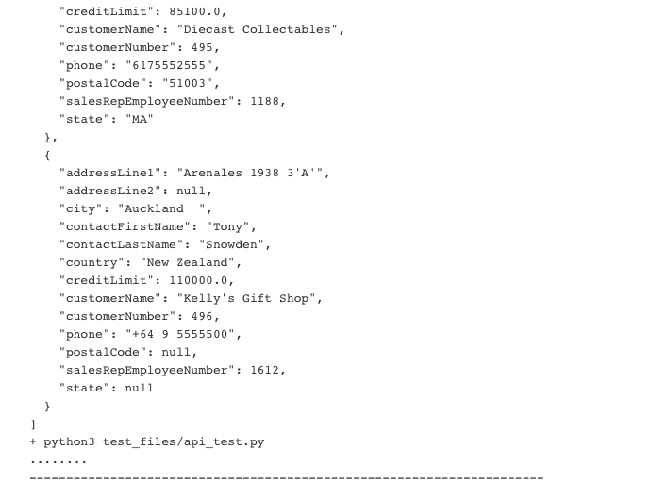
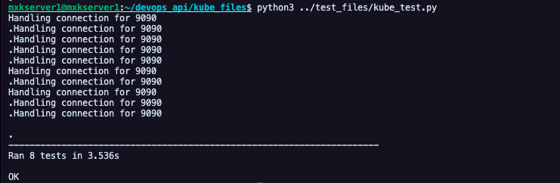
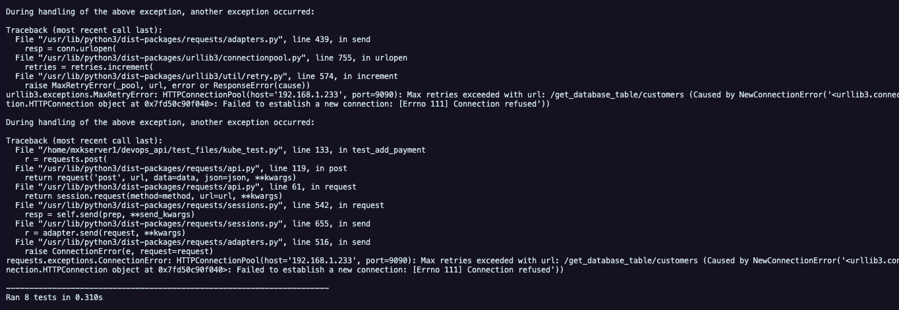
Testing
Using curl
api_test.py for CI/CD or development testing
kube_test.py for Deployment testing

Slide 12
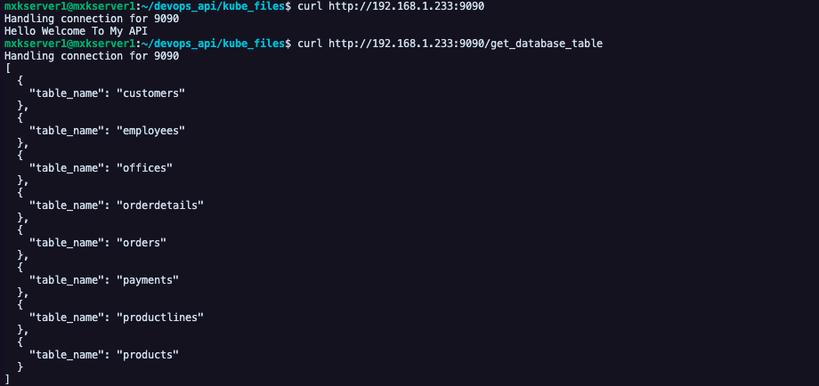
Demonstration

Slide 13
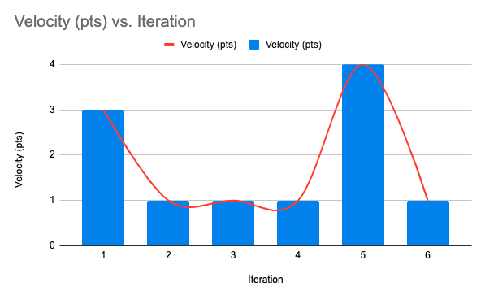
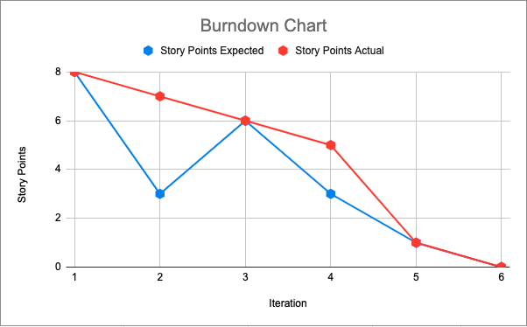
Challenges and improvisations

Slide 14
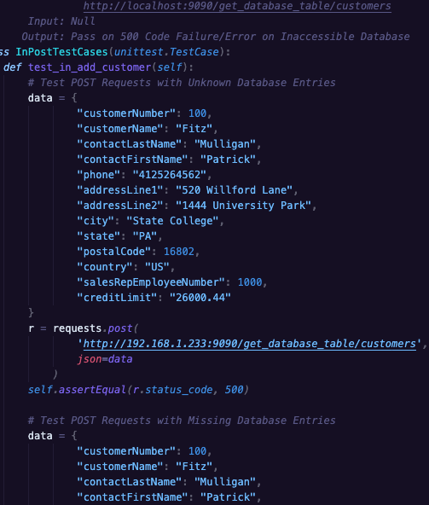
challenges
Connecting the API containers to MariaDB database
Adding persistence to Database (Needed to wait) Kubernetes, and deployment control flow
Not Resolved: Automatically Pushing and Merging GitHub repositories

Slide 15
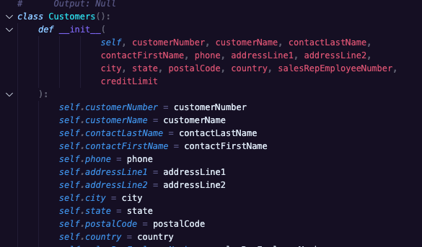
Improvisation
Shell script files that delete test entries from database
Pipfile for additional development

Slide 16

Additional features for future versions
Getting from all tables in database
Additional SQL inquiries to the database
Selective SQL inquiries to the database
Address missing or new data sent to database
Deployment on AWS

